Slide 1
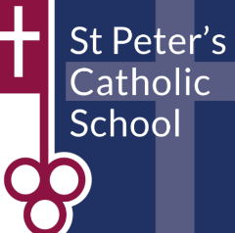
 | AFTERSCHOOL ACTIVITY | VENUE | TEACHER
MONDAY | Year 7 & 8 Boys Rugby Year 7 Girls Netball & Netball Leaders Year 9 Boys Football Year 10 Boys Football Year 8-13 Girls Badminton | Rugby Pitch Netball Courts Football Pitch Football Pitch Sports Hall | LBA LSB MPR JRI EHA
TUESDAY | Year 11 Boys Football Year 9,10 & 11 Rugby Years 8-12 Girls Netball & Netball Leaders Year 7 & 8 Trampolining | Football Pitch Rugby Pitch Courts/Sports Hall Gym | LBA MPR LSB & EHA JRI
WEDNESDAY | Year 9,10 & 11 Handball Year 8 Boys Football Year 7 Boys Football All Girls Football Upper School Netball Coaching | Courts Football Pitch Football Pitch Football Pitch Sports Hall | LBA JRI MPR EHA Surrey Storm Coaching
THURSDAY | Lower School Netball Coaching | Sports Hall | Surrey Storm Coaches
PE Extracurricular Clubs – Term 1

