Slide 1


All Slides will be shared with you online
Welcome to Year 7
Partnership Evening 2025

Slide 2
What a difference a few weeks makes...

Slide 3
Our
Year 7 motto

Slide 4
Christ to All

Slide 5
Our aims as a school this year
That we are able to build a brilliant community atmosphere, within and across year groups
Every student can learn, disruption-free, everyday
Everyone gets the chance to experience new things and opportunities
Everyone works their hardest to help everyone else achieve their potential
We spend time reflecting on our values and faith

Slide 6

How we communicate with parents
We now use Arbor as our Parent Portal Login
Look here for information on:
Attendance
Behaviour: Positive & Negatives
Reports
************************************************************
To get in touch with a member of staff, please send an email and allow us up to 48 hours to reply
You can use info@st-peters but it is much quicker to email staff directly – see website for staff names
PLEASE read all parentmails – check for them at least once a week

Slide 7
Brilliant basics
Uniform
Punctuality and attendance
Organisation
Excellent behaviour
Attitude to learning
Homework
Responsibility for learning

Slide 8
Punctuality and Attendance
School starts at 8.45am - please ensure your children are here in good time to get the day off to a flying start
Excellent attendance is key to achievement at GCSE and beyond
A bit under the weather? Send them in!
Contagious? Keep at home.
We will always call you if a student becomes more unwell during the day and needs to come home.

Slide 9

Pastoral Support
Head of Year: Mrs Hegg
Assistant Head of Year: Mrs Spenser
Year 7 Tutors
SEN: Mrs Power and Mrs Blackbourn
Chaplain: Riya
ELSA/HLSW: Sarah Mastromarco
Young Carers: Mrs Hardy
School Nurse:
School Counsellor: Angie Hemmings
Other Counsellors: Matrix, Barnado's
6th Form Mentors:

Slide 10
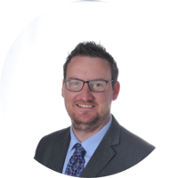
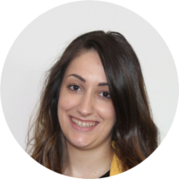
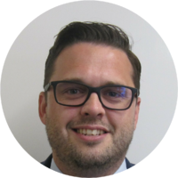
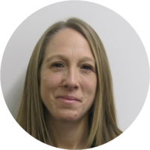

Mr Ebenezer, Assistant Headteacher, Designated Safeguarding Lead (DSL)
Mr Evans, Deputy Headteacher,
Deputy DSL
Mrs Fraser, Deputy DSL
Mrs Rana-Brown Assistant Headteacher, Head of Sixth Form, Deputy DSL
Mrs Ward, Deputy DSL
Safeguarding
If you have safeguarding concerns about a child, please contact our
Safeguarding team.

Slide 11
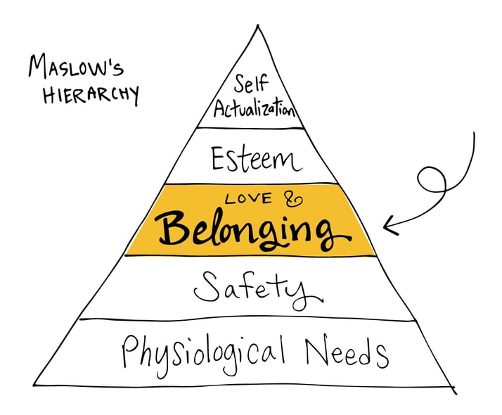
Our Behaviour Policy at St Peter’s is built on this vision:
To have disruption free learning and provide students with the opportunity to live out
the the Rocks of St Peter’s, building a deeper sense of belonging.

Slide 12
How we investigate incidents to make
St Peter's a safe, fair place
Gather evidence and listen
Try to understand context
Apply behaviour policy (if necessary) in a consistent way
Offer support to any victims and any perpetrators
Contact parents and log any sanctions on Arbor
Follow up with restorative conversations – every child gets a clean slate.

Slide 13


St Peter’s Rocks Nominations:
Top 10 nominated students per category to receive a St Peter’s Rock badge each half term.
Collect all 5 over the year to achieve a St Peter’s Keys badge.

Slide 14
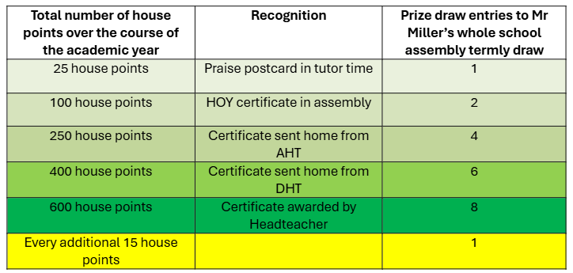
House Points:
All staff praise the students as much as possible
Notes:
are.

Slide 15
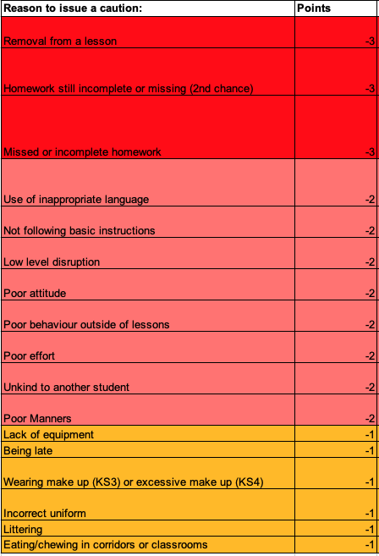
Cautions
Cautions will be split into 3 categories:
Cautions accumulate over the course of the week and reset every Monday.
The more cautions accrued = a longer length of time in an afterschool detention on a Monday. (Between 45m to 1h30m)
SLT detentions will run after school for 2 hours every Wednesday.
Further information can be found published in the behaviour policy on our website

Slide 16

Equality, Diversity and Inclusion at St Peter’s
At St Peter’s we are committed to all students feeling equally included and loved within our community. We are opposed to all forms of discrimination based on any protected characteristics outlined in the Equality Act of 2010.
We are committed to upholding and teaching these values to all students at St Peter's.
Examples of opportunities available:
Termly EDI assemblies that are topical and relevant
Surveys around how included and safe students feel at St Peter's
Weekly bulletin resources looking at celebrating diversity in the world
LGBTQ+ safe space
Identity Team badges worn by staff who can be approached about identity-based issues
Tutor time activities that celebrate and promote EDI
Notes:
spprach as well as sanctions where necessary.

Slide 17
Online Safety and Phone Use
A few measures we can put in place:
The school's no smartphone policy for Year 7 is vital
Adhere to age ratings for websites / apps , e.g. Whatsapp is 16, most others are 13
Have boundaries with phone use at home, e.g. time, location
School and home can and will educate children about the law, risks, and consequences of certain online behaviours
Keep up a dialogue with them so we help them in partnership
Model healthy phone / app use ourselves
Please come to our Parents Online Safety Forum – Thursday 6th November at 6.30pm

Slide 18
Reading and Sparx
Encourage your child to read 30 minutes every day
It improves academic attainment
It's a life skill and a source of escape and relaxation
All Year 7s are now using Sparx, our online reading platform, and you have been sent parentmails about this.

Slide 19
Key Dates 2025/26 | Event
Thurs 9th Oct | Year 7 Welcome Mass in St Pius
Fri 17th Oct | Inset day
W/C 27th Oct | Half Term
Fri 14th Nov | Inset day
Fri 21st Nov | School open – students can wear own clothes!
Mon 1st Dec | School Closed
Fri 19th Dec | End of Term from 12.30pm
Mon 5th Jan | Spring Term 1 starts
Mon 19th Jan | Inset day
Tues 20th Jan | 'Hercules' theatre trip
W/C 16th Feb | Half Term
Key Dates 2025/26 | Event
Fri 13th March | Inset day
W/C 30th March | Easter holidays
Mon 13th April | Summer Term 1 starts
Mon 4th May | Bank Holiday
W/C 25th May | Half term
Thurs 25th June | Sports Day
Fri 26th June | Feast Day
Fri 17th July | End of Term from 12.30pm

Slide 20

The St Peter’s English Department

Slide 21
English at St Peter’s
Resilient, inquisitive, motivated learners
A diverse curriculum to engage and inspire our students
Developing empathy and reflection
Inspiring a love of reading
Empowering students to infer, evaluate and analyse texts
Developing and challenging perceptions of society
Inspiring confidence in communication
Empowering critical, evaluative writers

Slide 22









KS3 Texts

Slide 23
English Overview KS3
Year | Term 1 | Term 2 | Term 3 | Term 4 | Term 5 | Term 6
7 | Fantasy Worlds | Charles Dickens: A Christmas Carol | Gothic Writing Unit | Poetry from Different Cultures and Introduction to Shakespeare Test Week: Reading and Writing paper | Michelle Obama: Becoming extracts | Patrick Ness: A Monster Calls
8 | Crime Fiction | Benjamin Zephaniah: Refugee Boy | Travel Writing | World War One Perspectives | Frankenstein: Test Week: Reading and Writing paper | Shakespeare: Much Ado About Nothing
9 | Dystopian fiction | Malorie Blackman: Noughts and Crosses | News Writing | Shakespeare: Romeo and Juliet | J.B. Priestley: An Inspector Calls | GCSE Transition Non Fiction Writing Unit Test Week: Reading and Writing paper

Slide 24
How we Assess in English
Reading
Writing
AO1: Identifying and interpret explicit and implicit evidence from different texts | AO3: Examine how time and place can influence how a text is written
AO2: Analyse how writers use language and structure to achieve effects | AO4: Evaluate texts critically and support this with appropriate textual references
AO5: Write imaginatively with ideas developed appropriate to form and purpose and accurate spelling
AO6: Describe using powerful vocabulary varied sentence types and punctuation for effect.
Speaking and Listening
AO9: Communicate ideas clearly using spoken standard English

Slide 25
Progression Within English
Focus on grammar and vocabulary
Developing independent reading and study
GCSEs are100% exam for English Literature and English Language
Speaking and Listening – communicating effectively
  Speaking and Listening
  Speaking and listening is still an important aspect of the English curriculum, as they will receive a certificate for it at GCSE. They will have 3 speaking and listening assessments throughout the year, focused on developing their presentational, listening and questioning skills.

Slide 26
Key Stage 3 Homework Policy
  25 minutes of homework a week
  SPaG focus to build on skills from primary school
  Set on Teams with clear instructions

Slide 27
Assessment in the English Department
Our focus is on students making progress:
  Assessed at least once a half term
  Whole class feedback
  Improvements in our DIRT lesson
  Assessment objectives
  Mastery descriptors: Aspiring, Expected, Exceptional
  Progress trackers
  Progression in skills

Slide 28
Year 7 Test Week
A one hour assessment in the classroom.
Students will be assessed on their reading and writing skills.
This is a summative assessment in which students will receive written feedback, for the different assessment objectives assessed throughout the units.

Slide 29
Setting in English
We no longer set in English.
From Year 8 onwards, students will be placed in mixed ability classes.
Research demonstrates that sets do not benefit student progress in English.
No tiered paper at GCSE and students studied the same texts regardless.

Slide 30
Our Top Tips
Discuss reading with your child.
Model being a ‘good reader’.
Provide a quiet place to complete study.
Encourage children to read a variety of fiction and non-fiction texts for 30 minutes a day
Encourage children to talk about what they are studying; what they are enjoying and finding challenging.

Slide 31

Welcome to the Maths Department
Year 7 Partnership evening

Slide 32
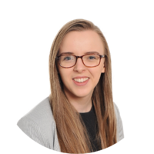
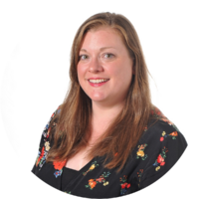
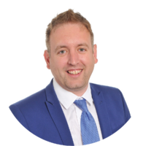
Maths Staff
Mrs K Taylor
Second in Maths
Mrs J Gregg
Head of Maths
Mr S Miller
Second in Maths
Mrs M Viljoen
Mr J Blackmur
Mrs D Hartley
Mrs R McAvoy
Ms A Foia
Mrs A Sawa​
Mr Fernandez

Slide 33
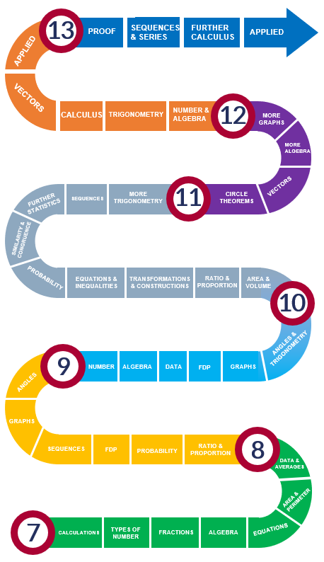
Maths Journey at St Peter’s

Slide 34
Key Stage 3 Mastery
We have identified 3 key skills in Maths: fluency, reasoning and problem solving
Each lesson focuses on these three skills, with specific questions focussed on each area
The aim is for all students to gain a deeper understanding of each topic
The mastery curriculum runs in Year 7 and Year 8

Slide 35
Examples of the key skills
Fluency | Reasoning | Problem solving
State the size of the digit 8 in the following: a) 218,000 b) 34,581 c) 8,000,000 Write the number 6472 in words. Write fifteen thousand four hundred and sixty two in figures. | Michael says, ‘Using the digits 0 to 9 we can write any number, no matter how large or small.’ Do you agree? Explain your reasoning. Lucy thinks that 1.422 is bigger than 1.43 because it has more digits. Is she correct? | 5 7 9 3 John is given the 4 number cards above, he uses all the cards to make two 2 digit numbers. What could the largest sum of these 2 numbers be?

Slide 36
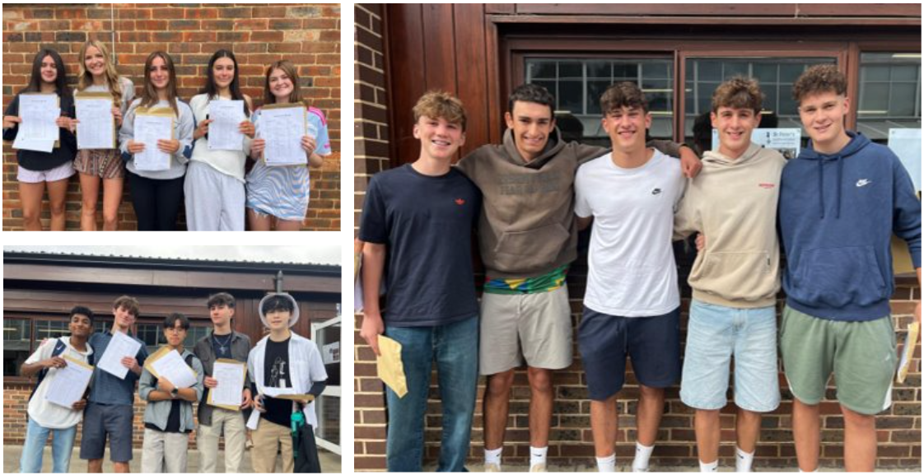
GCSE
Starts in Year 9
Continues Mastery theme of building topics on previous learning
2025 Results
40% 7-9
78% 5-9
95% 4-9

Slide 37
A-Level Maths
Post-18 destinations
University of Exeter – Mechanical Engineering
University of Surrey – Economics and Finance
University of Cambridge – Natural Sciences
University of Cambridge – Mathematics
University of Kent – Biochemistry
University of Bristol – Medicine
University of Essex – Law
We offer A-Level Maths and Further Maths courses
2025 Results
82% A*-A
93% A*-B
55 students
Bournemouth University– Software Engineering
University of Bath – Accounting and Finance
Degree Apprenticeship at BAE
Kingston University – Forensic Science

Slide 38
Beyond the classroom
UKMT Maths challenge
Chess Club
Inter-school Maths competition
Additional Maths GCSE studied afterschool in Y11. A standalone GCSE that prepares students for A-Level Maths

Slide 39
Assessments
Students will be assessed at the end of each half term
Each test is broken down into 3 parts, with questions on fluency, reasoning and problem solving

Slide 40
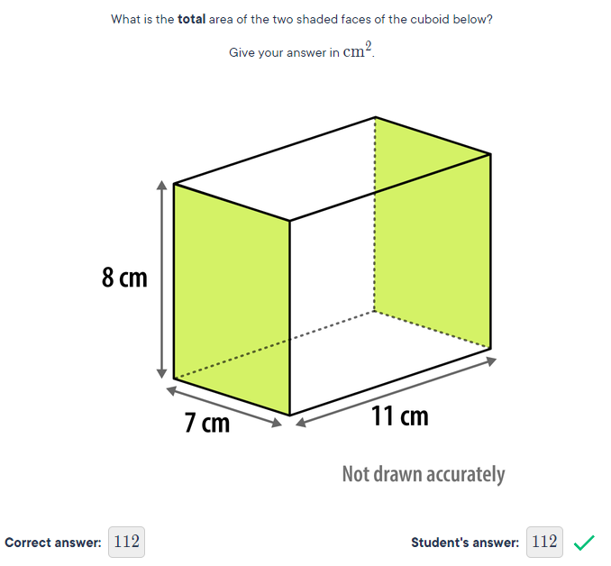
Sparx Homework
Students receive 60mins
Set weekly on a Wednesday
Has to be 100% complete
Support
  Watch online videos
  Email or speak to your teacher

Slide 41

The best support you can give your child in maths is confidence! ​
Remind your child we are all mathematicians (even if you don’t feel so confident yourself!)
On a practical level, support your child with their Sparx by doing the following:
Check they are writing out their workings in their book
Check they have watched the video clip or looked back at their notes if they are stuck with a question
It should be taking them an hour in total, spread over the week (Wednesday to Wednesday)
Try not to help them with the questions as Sparx will start to make the work harder

Slide 42
What is Sparx?
Personalized homework with questions that are challenging yet achievable
The majority will be based on recently learnt topics, but will also include some questions from previous topics to help reinforce their learning
Students access their homework on their online Sparx account
While homework is accessed online, it is predominantly a written homework and students should record their work in their orange Maths book

Slide 43
How can I support my child?
Provide a quiet space for your child
Encourage them to start their homework early so they can get help from their teacher before the deadline
Check the weekly email you’ll get from Sparx and praise your child for starting or completing their homework.
Try not to help your child with a question until they’ve had a go first.

Slide 44
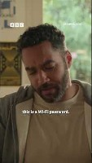
https://www.youtube.com/shorts/DMEWj_w_VT0

Slide 45

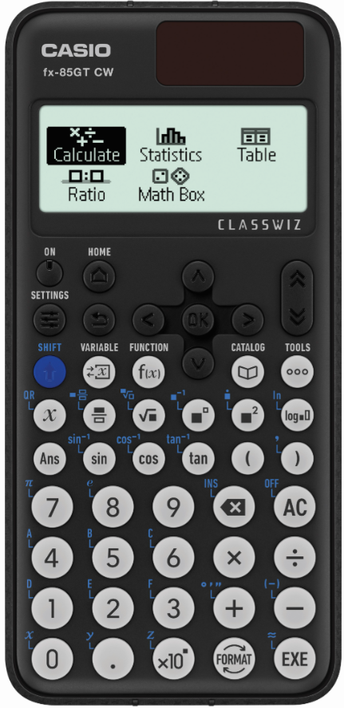
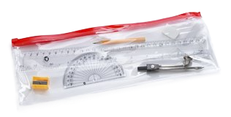
Equipment
Maths pack containing (pencil, pen, ruler, protractor, compass, rubber) £1.50
Casio FX85GTX-CW £13
White board pens 50p

Slide 46

Religious Education at St Peter’s
Mr Legrand – Joint Head of RE

Slide 47


Slide 48


Slide 49


What is the purpose of RE in Catholic schools?

Slide 50
What is the purpose of RE in Catholic schools?

Slide 51



Students will be asked to demonstrate the following ways of knowing:
Discern
Respond
Understand
AIM:
In this way of knowing, we are aiming to help pupils to be able to judge wisely in response to different interpretations of the meaning, significance and implications of texts, beliefs, rites and ways of life so that they can arrive at justified conclusions about what is true, what is good and what is beautiful.
AIM:
In this way of knowing, we are aiming to help pupils to be able to understand deeply the meaning of sacred texts, religious beliefs, sacred rites and the lives of individuals and communities who are shaped by these texts, beliefs and rites.
AIM:
In this way of knowing, we are aiming to help pupils reflect personally and with integrity on what they have learned and consider the implications for action these may have for their own lives and the world in which they live.

Slide 52
RE in Key Stage 3
RE follows a spiral curriculum in Key Stage 3, which allows students to deepen and extend their knowledge each year and develop a range of useful skills
Creation & Covenant
Dialogue & Encounter
Creation & Covenant
Dialogue & Encounter
Creation & Covenant
Prophecy & Promise
Dialogue & Encounter
Prophecy & Promise
Skills developed in RE:
Knowledge
Religious Evidence
Evaluation
Impact
Primary RE
Prophecy & Promise
To the Ends of the Earth
To the Ends of the Earth
To the Ends of the Earth
Galilee to Jerusalem
Desert to Garden
Galilee to Jerusalem
Desert to Garden
Galilee to Jerusalem
Desert to Garden

Slide 53
What will we study this year?
Creation and Covenant:
We will explore how creation is at the heart of God’s relationship with humans, asking questions such as: what caused the universe, and why are we here?.
2. Prophecy and Promise:
We will investigate why the Bible, known as scripture, is an authoritative (or trusted) text and how the Bible is a library of books with many different literary forms.
3. Galilee to Jerusalem:
We will consider the key question of who Jesus was. The scriptures of the Old Testament preparing for a Messiah, as well as why Jesus is known by many titles and their meaning.
4. Desert to Garden:
We will examine how, in Exodus, the events of the Passover foreshadow the final meal and sacrifice of Jesus. We will also explore what Catholics and other denominations believe about the Eucharist.
6. Dialogue and Encounter:
This explores the development of the Catholic Church and how it has dialogue within itself to develop Catholic dogma. You will also encounter the faiths of Judaism and Islam in relation to the year’s curriculum themes
5. To the Ends of the Earth:
Jesus’ message needed to be spread to all people, in all places and for all time, starting with the story of Pentecost and the role of the Holy Spirit.

Slide 54

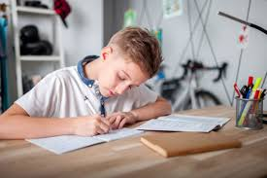
Homework
The majority of homework tasks will have a literacy and/or creative focus.
Students will be asked to learn the spellings and definitions of key terms, and demonstrate that they can use these terms appropriately.
Students can also expect one creative homework task per unit of study which may involve a personal response to the topic being studied.
All homework tasks will be set on Teams and will have a clearly defined deadline.

Slide 55
Assessments
There will be six assessments across the year (at the end of each unit), as well as a Test Week assessment.
Three assessments will be multiple choice questions designed to test the range and depth of understanding and discernment.
Three assessments will be longer written answers to assess skills in using religious evidence, evaluation and your understanding of impact as well as knowledge.
All assessments will be recorded and can be accessed by parents and students.

Slide 56
2025 Science slides
Year 7 Presentation Evening

Slide 57


Science
We want to guide all students to become inquisitive, independent and inspired science students, who have an excellent foundation of knowledge and who use their skills to better understand and improve the world around them.

Slide 58
Why science is important
Science mindset begins with asking questions
Analysing and evaluating evidence
Responding and adjusting to feedback
We want to guide all students to become inquisitive, independent and inspired science students who have an excellent foundation of knowledge and who
use their skills to better understand and improve the world around them.

Slide 59
KS3 Science at St. Peter’s
At KS3, students can develop a fundamental understanding of the world.
Focus on core scientific themes and skills (mastery)
Develop skills for scientific investigation

Slide 60
Topics Year 7,8 and 9
Biology
Cell Structure and Function Organ Systems Photosynthesis and Respiration Variation and Evolution
Chemistry
Particles Periodic Table Chemical Reactions and Energy
Physics
Forces Energy Electricity and Magnetism Waves

Slide 61
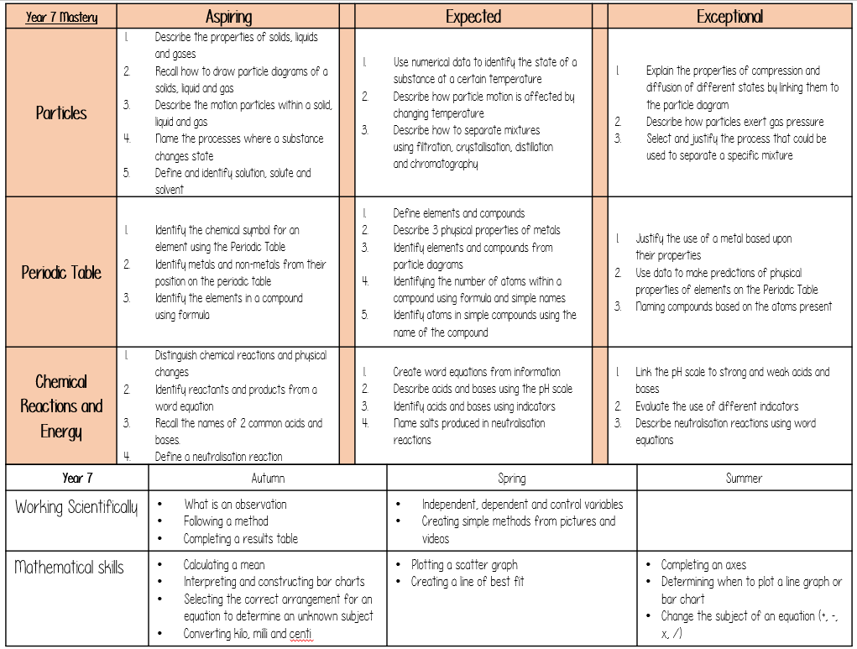
Stuck on the inside front cover of students books.
Describe/comparing (often relies on recall of facts) and simple processes
Complex description, explanation. Analysing new information
Recall of facts and simple skills
Skills – developed through the year

Slide 62
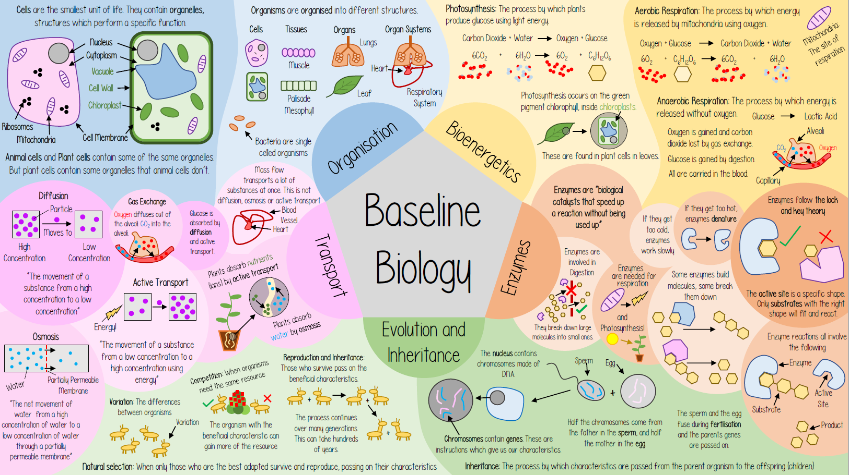
What do the students need to know

Slide 63
Practicalities:
Assessment: 3 assessments per year (one will be multiple choice, computer based)
  Questions are graded aspiring, expected and exceptional
  Students are graded aspiring, expected and exceptional.
Teachers: Most students will have 3 teachers, focusing on the 3 different subjects
Setting:
  Year 7 and 8: science in forms, Year 9 = science in sets, Year 10 = sets finalised for GCSE
  Primarily based upon the final assessment of the year. Teachers will discuss borderline students and check against progress and attitude through the year
Homework: Pupils will receive one Biology, one Chemistry and one Physics homework per fortnight. 20-30 minutes. Usually focused on building the fundamental knowledge shown on the previous slide. We are trialling this year Sparx science an online package

Slide 64

How can you support learning?
Avoid saying ‘I don’t get science’ – everyone can learn science. It is a process.
Praise their efforts
Help them (organisation – especially books and homework, encourage active learning = flashcards, questions and answers)
Direct students to resources – BBC Bitesize, Science KS3 CGP guide
Ask questions and bring science into the conversation:
  What did you learn about today in science?

