Slide 1


Welcome to
Year 7 Parent Partnership evening
2025

Slide 2

Form time
8.45am-9.05am every day
Registration – they need to be here on time
We always pray together: sets calm tone for day
I check in with everyone and answer queries
I check uniform and equipment
We have a routine:
  Monday – Student bulletin (you can also view)
  Tuesday – Reading
  Wednesday – Assembly
  Thursday – Pastoral Curriculum
  Friday – Tutor choice

Slide 3
Uniform
Year 7 students look fantastic this year – thank you!
Please put name label on everything
PE kits need a regular wash or the lockers start to smell!
School shoes, never trainers
A warm, waterproof coat and umbrella is needed
School website lists uniform requirements
Speak to Mrs Hegg if any help needed (we have some secondhand uniform we can share)

Slide 4
Food
Year 7 students love the canteen food!
You can top up their accounts using ScoPay
You can also see what they are buying
Please keep it topped up as the canteen can't give credit as in previous years
We don't have lunch until 1.30pm, so students often have early lunch at 11am break OR a snack
Please give them lots of healthy snacks and a water bottle – well fed children learn (and behave!) better

Slide 5
Timetables
We have a 2 week timetable: Week A and B
Your children have a paper copy and a keyring with their timetable on it
You can also see their timetable on Arbor
Good idea is to print off a paper copy and stick on the fridge or on their desk at home
They can ask me for spare copy if needed
Packing bags the night before school is a really good habit

Slide 6
Homework
Students should get around 4 hours per week in total
Each subject should only set up to 30 minutes homework – if your child needs longer than that, they could finish after 30 minutes and you could sign their exercise book
If it is taking longer than 30 minutes, the teacher will want to know
Students stress about homework and we don't want this – we are getting them into good routines
We run a homework club at lunchtime in E10 and afterschool in LR2 until 4.15pm (both are computer rooms)
Talk to Mrs Hegg if any concerns

Slide 7
Clubs and Extra-Curricular events
School is about so much more than the academic work.
We want your children to have fun, get some exercise, widen their friendship group, build their self-confidence...
Encourage your child to join at least one school club; please refer to the booklet sent out 19th September
Clubs are advertised each week in the Student bulletin – any changes are mentioned here so students and parents should take note
Other places to go at lunchtime: the LRC or the Chapel or E10

Slide 8
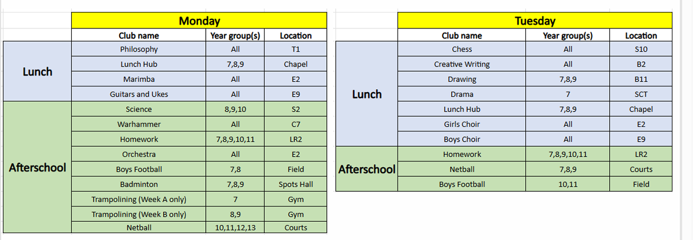
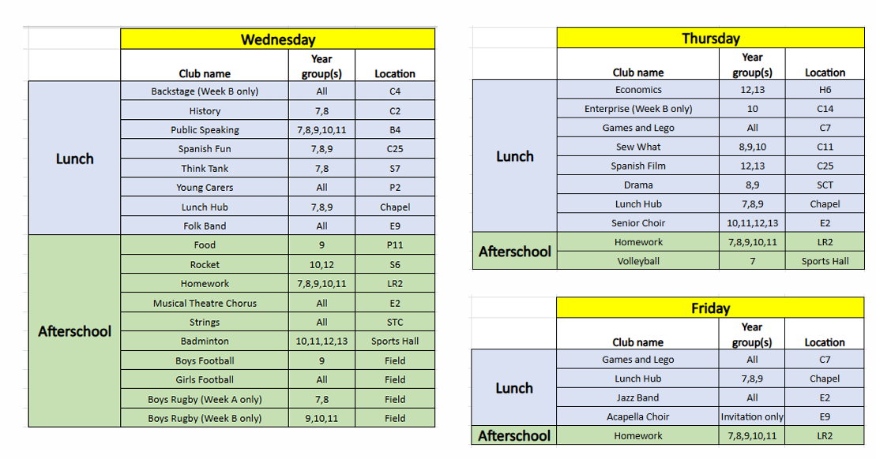
Lunchtime and After school Clubs Autumn 1
Mrs Hegg will re-send you the Clubs booklet.
You can also see it in your Parentmails

Slide 9
Other Year 7 Trips and extra-curricular experiences
For All:
Author visit
English - Christmas Carol workshop and performance
Feast day walk
Maths – Junior Maths Challenge
Careers talks
RE – Mandir visit
Reflection day
Sports day
Opportunities​ for some:
Arundel Pilgrimage/ Annual Schools Mass​
Student leadership action team (SALT)​
SATROFest ​
Theatre Trip – Hercules'​
Thorpe Park rewards trip ​
Worth Abbey/Good Shepherd Celebration ​
Young carers trip

Slide 10
Behaviour
We want to encourage a very positive culture so reward students with as many house points as we can
You can see how your child is doing on Arbor
We celebrate good behaviour as often as we can – thanks for doing the same at home!
If you see any Cautions listed on Arbor, you can read the teacher's comments to see why the Caution has been given
We expect children to accept Cautions and 'take them on the chin' and learn from them
If you think a genuine mistake has been made, get in touch with teacher or myself (or Mrs Hegg if a wider concern)

