Slide 1
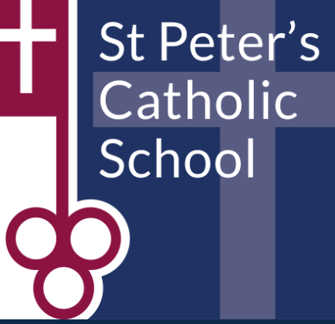

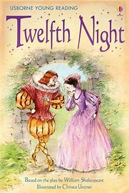
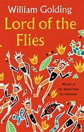



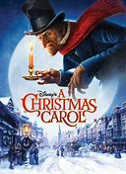


The English Curriculum
Year 7
2021-2022
What Year 7 English lessons are all about
Homework
Assessments
Setting
KS3 overview
How you can support your child in English

Slide 2

What are Year 7 English lessons all about?
Content
In Year 7 and indeed throughout KS3 and KS4, Students will explore a variety of English literature texts in the form of poetry, plays and novels.
For English language, students will be developing their writing skills experimenting with different styles of creative and transactional writing.

Slide 3
What are Year 7 English lessons all about?
Incorporating Grammar
  We will teach grammar lessons specifically at appropriate times during the term, depending on the need of the class. English teachers will also address grammar in all English lessons through their teaching of the Reading and Writing units in year 7.
  Alongside this, we have liaised closely with Year 6 teachers so as to ensure we continue to develop students’ literacy skills in areas they studied during lockdown or may have missed due to Covid.
Independent reading and study
  We encourage students to share their reading passions; explore new genres as well as examining the writers’ craft. A task your child may have enjoyed before they started here, was to complete a book report and share it in one of their first English lessons. We have reading lists available for each Key stage and encourage wider reading as much as possible.
  .

Slide 4
Speaking and Listening
  Speaking and listening is still an important aspect of the English curriculum, as students will receive a certificate for this as part of their English Language GCSE.
  Students will have 3 speaking and listening tasks throughout the year, focused on developing their presentational, listening and questioning skills.
  These are not assessed as we want the students to enjoy presenting in a range of different individual, paired and small group situations, without feeling the pressure of being assessed

Slide 5
Key Stage 3 English Homework Policy
Students are given two pieces of homework, each week, which should take 30 minutes.
Possible homework may include:
  Developing work set in class, in order to demonstrate learning and independence.
  Reading – usually accompanied with a short summary or parental signature.
  Creative writing: short story, diary entry or article writing.
  Planning or mind-mapping in order to revise a topic.
  Spellings to support the learning in class. These may be key word spellings or individual spellings that the student has problems with.
  Practising a speech at home for delivery in class.
  Interviewing a family member or friend about a topic relating to the class work.
  Takeaway menu – students own choice from list provided.
  DIRT paragraphing writing.

Slide 6
Assessments in the English Department
  At the beginning of each unit, we will complete a mini review.
  Following the mini review, whole class feedback is provided to the students, focussing on areas students have performed well in and areas of development.
  Students then improve their work in feedback lesson, in which they work on developing their reading and writing skills, so as to help them master the assessment objectives. Students set themselves targets for the rest of the unit. We call this ‘DIRT’ (dedicated individual reflection time).
  End of Unit Assessments: We assess students at the end of each half-term using the mastery descriptors, based on assessment objectives they are being assessed on for that specific unit. These descriptors are then recorded on Go4schools and students write their targets in the front of their English books on progress trackers.
  The mastery descriptors are aspiring, expected and exceptional. On Go4schools we record this as a C for aspiring; B for expected and A for exceptional.
  We encourage students to continuously review and edit their work, in order to master and develop their confidence with the different literature and language skills and to enable the best progress for each student.

Slide 7
End of Year 7 Assessment/exam
A one hour assessment in the classroom.
Students will be assessed on their reading and writing skills generally and not on one specific Scheme of work or text.
This is summative assessment in which students will receive written feedback for the different assessment objectives assessed throughout the units.
This helps mirror the same expectations required to prepare students for their GCSE exams in Year 11 for English Language and English Literature which are 100% exam.

Slide 8
How we Assess in English
Reading Skills:
Writing Skills:
Speaking and Listening:
AO1: Identifying and interpret explicit and implicit evidence from different texts | AO2: Analyse how writers use language and structure to achieve effects | AO3: Examine how time and place can influence how a text is written | AO4: Evaluate texts critically and support this with appropriate textual references
AO5: Write imaginatively with ideas developed appropriate to form and purpose and accurate spelling | AO6: Describe using powerful vocabulary varied sentence types and punctuation for effect.
AO9: Speaking and Listening : Communicate ideas clearly using spoken standard English

Slide 9
English Overview KS3
Year | Term 1 | Term 2 | Term 3 | Term 4 | Term 5 | Term 6
7 | Skills for Writing Unit: Alter Egos | Dickens: A Christmas Carol | Gothic Writing unit | Morpurgo: Private Peaceful | Writing Unit: Writing the World | Test Week: Reading and writing paper Poetry Other Cultures
8 | Skills for Writing: Spy Fiction | Golding: Lord of the Flies | Travel: Writing unit | Frankenstin Playscript | Poetry: World War One | Test Week: Reading and writing paper Introduction to Shakespeare: Twelfth Night
9 | Skills for Writing Unit: Dystopia | Steinbeck: Of Mice and Men | Writing Unit: News Writing | Shakespeare: Romeo and Juliet | An Inspector Calls | Test Week: Lit paper An Inspector Calls GCSE Transition Poetry unit

Slide 10
Setting in English
We do not set in Year 7 in the English department.
We set from Year 8 onwards and base this on student’s progress within the assessment objectives in Year 7, alongside data from primary school.
Sets are not fixed and are reviewed by teachers throughout the academic year.
Students are set so that they may make the best progress they can.

Slide 11
How you can help
  Encourage children to read for 20 minutes per day.
  Discuss reading with your child.
  Model being a ‘good reader’.
  Provide a quiet place to complete English homework.
  Encourage your child to talk about what they are studying in English; what they are enjoying and finding challenging.

