Slide 1


Psychology Handbook
A Level Psychology [7182]
It is advised that you use [play] this in slide show mode.

Slide 2
Contents
Exam structure
Mathematical requirements
Assessment folders
Independent Study
Assessment Objectives
Grade descriptors
Support
Writing essays
Course overview
Textbooks
Missing a lesson
Command words
Route through the A Level
Folder Organisation
Homework
Careers
Note: Each of these buttons are hyperlinked if you are in the ‘slide show’ mode.

Slide 3
Exam structure
At the end of year 13 you have 3 exams (see specification for more detail):
In these exams, you will have a mixture of short and long answer questions, including at least one 16-mark essay (6 marks AO1 + 10 marks AO2/3). You will be expected to show knowledge and understanding of research methods and mathematical skill in all papers.
Each paper is worth 96 marks in total and lasts 2 hours.
Time Allocation for A-Level answers:
1 mark = 1minute 15 seconds
Therefore, a 16-mark essay = 20 minutes
If you have extra time you will gain an additional 25% of the time
7182/1: introductory topics in psychology | 7182/2: Psychology in context | 7182/3: Issues and options in psychology

Slide 4
Assessment Objectives
Each paper covers all 3:
At least 25 – 30% of the overall assessment will assess skills, knowledge and understanding in relation to research methods.
Overall, at least 10% of the marks in assessments for psychology will require the use of mathematical skills. These skills will be applied in the context of A-level Psychology and will be at least the standard of higher tier GCSE mathematics.
AO1 = Knowledge and understanding Description of knowledge should be exact/precise Descriptions need to be detailed There is generally a need for more than one descriptive example/study to gain access to the higher bands of marks Inclusion of irrelevant material (‘waffle’) and incorrect material will restrict marks gained through poor selection and lack of accuracy | AO2 = Application of knowledge and understanding Application of knowledge to unseen examples This must be linked to theoretical knowledge Explicit links to the scenario to gain full credit | AO3 = Analysis, interpretation and evaluation To gain access to the higher band of marks requires: Evaluative points to be fully explained, elaborated and developed A clear expression of ideas Correct use of terminology

Slide 5
This is the whole course in summary.
If you would like to view the full specification you can do so on the AQA Psychology Subject Page.

Slide 6
Route through the A Level
This is how we will approach the topics and roughly when they will sit across the two years.
You will be given a copy of this at the start of year 12. However it may be updated, you will find an up to date, printable version on SharePoint.
This is subject to adjustment for September 2023

Slide 7
Mathematical skills
Remember that a minimum of 10% of your marks will come from mathematical content.
You can find the detailed list of mathematical skills on the specification here : Mathematical requirements and exemplification
If you would like some additional help with this content, this is one of the many useful resources that exist:
  Tutor2u A-Level Psychology Statistics & Mathematics Workbook

Slide 8
Intro to psychology course
If you want a bit more of an intro, tutor2u offer a free introduction course. Follow the link below if you’d like to …
https://ondemand.tutor2u.net/students/introduction-to-aqa-a-level-psychology

Slide 9
GRADE DESCRIPTORS
A* - C
You will need to click through.

Slide 10
To achieve grade A*:
Knowledge: Shows breadth and depth of knowledge in all areas of the course, high level of accurate detail and precision. Goes beyond what is ‘required’ by the specification. Appropriate selection of material to address the question (not a ‘stock’ answer).
Understanding: Able to perceive links between topics and explanations; compare relative strengths and limitations of different approaches; consider the wider societal implications of various explanations with sensitivity and maturity.
Use of scientific terminology: Scientific terminology is used accurately and appropriately to ensure precision. Does not use ‘definitive’ terms (e.g. prove) or personal pronouns. Clear distinction between reliability and validity, between reductionism and determinism. May show understanding of how they are linked/overlap without losing clarity.
Application of knowledge: Goes beyond the STEM; targeted application based on what is provided. Has identified precise theoretical link, explained how this is an example and quoted from the given scenario (or reading between the lines).
Discussion: Uses a variety of language to avoid repetition, uses a variety of sentence structure to provide interest. Elaboration is focussed and detailed. Able to show an understanding of both sides of a scientific argument. Discussion points are based in evidence rather than anecdotal. Uses research evidence effectively to illustrate points (no unnecessary detail). Includes a variety of discussion points to show breadth of understanding (RAID).
Structure: Response is focussed on the question. Structure is appropriate for the question given (e.g. outline & evaluate or discuss). There is a clear flow of ‘argument’ in longer responses. Answers are clear and coherent, and appropriate for the number of marks available. Effective balance between assessment objectives.
Mathematical skills/Research Methods: able to effectively manipulate and interpret statistical information (both qualitative and quantitative), calculations should be clear and precise, showing full and logical thought process. Demonstrate a detailed understanding of all research methods, be able to assess their relative benefits and associated implications for understanding behaviour. Be able to design valid, reliable and ethical research into a variety of areas using all research methods in a precise manner.
Extra: reading beyond what is required by the specification, has an ability to understand academic articles and will have considered the theoretical links to contemporary issues. Focussed in & on time to lessons, able to effectively support their peers without unnecessary distraction and will be continually trying to further develop their skills and understanding (e.g. though exam questions). Has appropriate equipment and preparation complete.
students’ evidence will show that they have securely met all the statements within the grade A descriptor, with stronger performance in most or all aspects of the grade A statements.

Slide 11
To achieve grade A, candidates will be able to:
Knowledge: Shows breadth and depth of knowledge in all areas of the course, high level of accurate detail and precision. Appropriate selection of material to address the question (not a ‘stock’ answer).
Understanding: Compare relative strengths and limitations of different approaches; outline the wider implications of various explanations.
Use of scientific terminology: Scientific terminology is used accurately and appropriately to ensure precision. Does not use ‘definitive’ terms (e.g. prove) or personal pronouns. Clear distinction between reliability and validity, between reductionism and determinism.
Application of knowledge: Goes beyond the STEM; targeted application based on what is provided. Has identified precise theoretical link, explained how this is an example and quoted from the given scenario.
Discussion: Uses a variety of language to avoid repetition. Elaboration is focussed and detailed. Able to show an understanding of both sides of a scientific argument. Discussion points are based in evidence rather than anecdotal. Uses research evidence effectively to illustrate points (no unnecessary detail). Includes a variety of discussion points to show breadth of understanding (RAID).
Structure: Response is focussed on the question. Structure is appropriate for the question given (e.g. outline & evaluate or discuss). Answers are clear and coherent, and appropriate for the number of marks available. Appropriate balance between assessment objectives.
Mathematical skills/Research Methods: able to effectively manipulate and interpret statistical information (both qualitative and quantitative), calculations should be clear and precise, showing full and logical thought process. Demonstrate a detailed understanding of all research methods, be able to assess their relative benefits and associated implications for understanding behaviour. Be able to design valid, reliable and ethical research into a variety of areas using all research methods.
Extra: this individual will have an ability to understand academic articles and will have considered the theoretical links to contemporary issues. They will be focussed in lessons, able to effectively support their peers without unnecessary distraction and will be continually trying to further develop their skills and understanding (e.g. though exam questions). They will arrive on time to lessons, with all appropriate equipment and preparation complete.
Demonstrate accurate and detailed knowledge of a range of relevant scientific ideas, processes, techniques and procedures; show understanding of most scientific ideas, processes, techniques and procedures; organise and present information clearly, using appropriate psychological terminology.
Engage explicitly and effectively with stimulus/contextual material to apply relevant knowledge and understanding of scientific ideas, processes, techniques and procedures in novel contexts (theoretical/practical) using stimulus information (quantitative/qualitative).
Analyse, interpret and evaluate relevant scientific information, ideas and evidence effectively and critically, to:
make appropriate judgements and draw sound conclusions showing sustained and substantiated reasoning. and/or
develop/refine practical design and procedures effectively and appropriately.

Slide 12
Characteristics that differentiate a grade B from a grade A:
Knowledge: Shows breadth and/or depth of knowledge in most areas of the course, information presented is accurate with some detail. Answer is shaped to the given question, and retains focus.
Understanding: Can effectively evaluate theories and research, considering both strengths and limitations. May be able to compare different explanations concerning their relative strengths. Shows an awareness of the wider implications of taking a specific approach to explaining behaviour.
Use of scientific terminology: Scientific terminology is used accurately. Does not use ‘definitive’ terms (e.g. prove). Clear distinction between reliability and validity.
Application of knowledge: Targeted application based on what is provided. Has identified theoretical link, explained how this is linked to the STEM using direct quotation.
Discussion: Elaboration is focussed and effective, use of PEEL. Able to show an understanding of both sides of the argument. Uses research evidence effectively to illustrate points. Includes at least 2 different types of discussion points to show breadth of understanding (RAID).
Structure: Response is focussed on the question. Structure is clear and logical. Responses are mostly an appropriate length for the number of marks available (e.g. 4 marks = 100 words)
Mathematical skills/Research Methods: able to effectively describe statistical information, calculations are clear, showing full thought process. Demonstrate an understanding of all research methods (some may be better than others), can evaluate different research methods. Be able to design research into a variety of areas using laboratory, self-report and observational methods.
Extra: They will be focussed in lessons, able to effectively support their peers and will be focussed on developing their skills and understanding (e.g. though exam questions). They will arrive on time to lessons, with all appropriate equipment and preparation complete.
knowledge will be mostly accurate and detailed but there will be occasional errors/omissions, indicating a lack of consistency.
links between psychological knowledge/understanding and a variety of stimulus material will be less thorough and well-focused, so aspects of application may not always be entirely effective.
arguments will be developed and mostly logical. Lines of reasoning will be mostly clear but there may be slight inconsistency in judgements/inadequacy in conclusions.
when refinement or further development of practical design and procedures is required, most suggestions will be competent and appropriate.

Slide 13
To achieve grade C, candidates will be able to:
Knowledge: Shows sound knowledge in most areas of the course, information presented is mostly accurate.
Understanding: Can effectively evaluate theories and research, considering both strengths and limitations. Shows an awareness of the wider implications of taking a specific approach to explaining behaviour.
Use of scientific terminology: Key terminology is used (e.g. validity and topic specific). Answers will be mostly clear, showing knowledge.
Application of knowledge: Targeted application based on what is provided. Has identified theoretical link, explained how this is linked to the STEM using direct quotation. Though this may be lacking in development.
Discussion: Shows an awareness of strengths and/or limitations of the given theory/research. Elaboration may be brief and generic though will make an attempt at considering the real world application of that strength/limitation. Often presents the same amount of AO1:AO3.
Structure: Response is relevant to the question. Responses to shorter questions may be in a bulleted list (some explanation is still required).
Mathematical skills/Research Methods: able to describe basic statistical information, calculations are mostly clear. Demonstrate an understanding of key research methods: experiments, self-reports, observations and can identify strengths and limitations of each.
Demonstrate reasonably accurate and detailed knowledge of some relevant scientific ideas, processes, techniques and procedures; show understanding of some scientific ideas, processes, techniques and procedures; organise and present information clearly in places, with some use of psychological terminology.
Apply relevant knowledge and understanding of some scientific ideas, processes, techniques and procedures in novel contexts (theoretical/practical) using stimulus information (quantitative/qualitative). Some application to stimulus/contextual material may be implicit.
Analyse, interpret and evaluate some relevant scientific information, ideas and evidence, to: make judgements and draw some conclusions showing an ability to reason and develop a line of argument and/or propose some effective and appropriate developments/refinements of practical design and procedures.

Slide 14
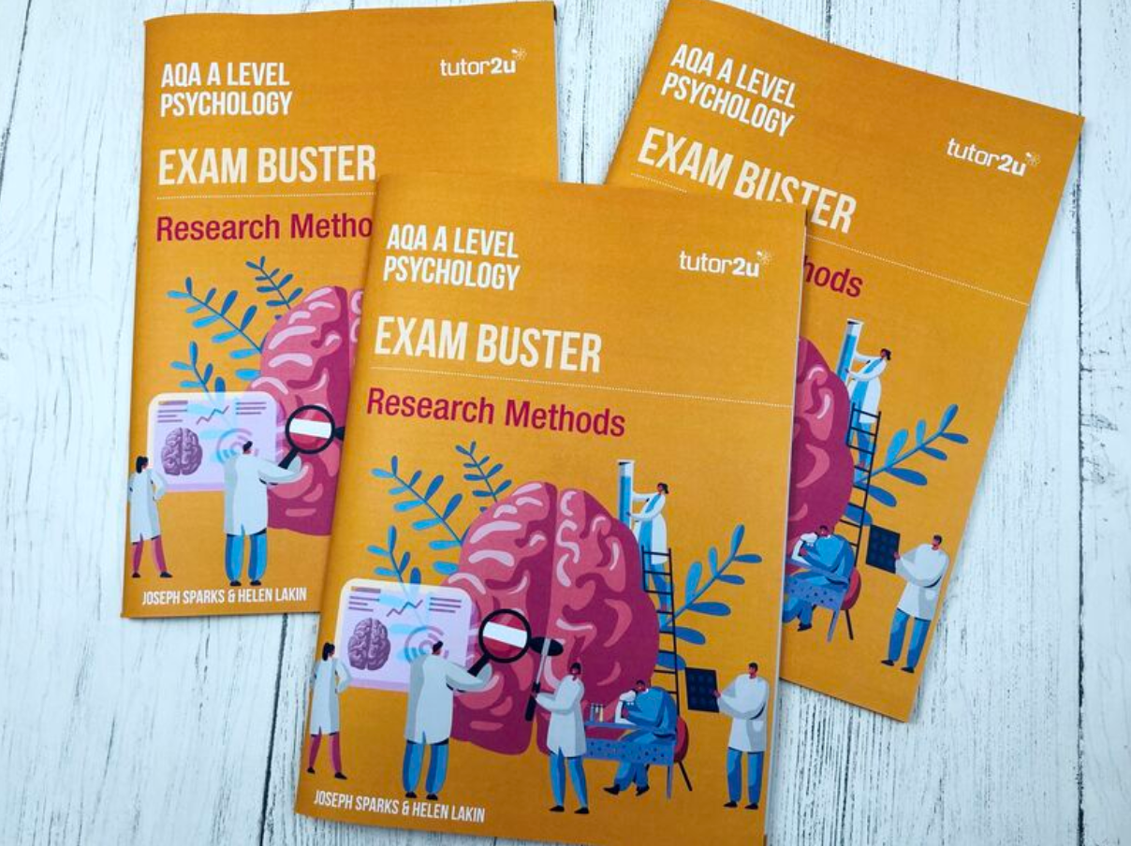
Textbooks
No expectation for full textbook (in either year)
You can get your own (cat) if you want, BUT
  You do have free access online, and …
  I have copies of the Green Hair in the class that can be used
You are expected to have your own copy of the Exam Buster: Research Methods
  Pay online, these will be ordered in bulk by the department.
  £7.95 each

Slide 15
Folders expectations
Folders should include:
Overview of the course
  On one page & route map
Sections for:
  Each paper and topic
    May end up with 3 folders (one per paper)
    You will need file dividers and topic checklists (on SharePoint)
  Independent study and wider reading
    including reading summary sheets
  Assessment reflection sheets
Once topic complete – filed away in order
Bring to assessment lessons for checking along with independent study
Formal Folder checks once a half term (2 this half term)
  26th September (folder ready?) + end of half term

Slide 16
Assessment Folders
All assessments in the folder
Summary tracker at the start – use this each assessment
Takeaway reflection document (which goes in your home folder) which includes actions
Different colour per group
Organise your folders using the file dividers.
  Mocks
  Paper 1
  Paper 2
  Paper 3
  Research projects

Slide 17
Support
SharePoint: Psychology watch/read list. Any of these would be good, you can find a quick summary and a rating for each on the document.
School Library: there are some extra texts up there – go have a look
Miss Miller’s Library: I have some interesting reads plus copies of the course textbooks – these must be signed out and back in. Many are my personal books – as such I don’t want them going missing!
Academic articles: those that we have studied plus anything you find interesting, just go on Google Scholar and search for what interests you, you will be able to read all abstracts and some you can download and read the full article.
Drop in to the open room for specialist support from Miss Miller

Slide 18
If I miss a lesson – what should I do?
Speak to a peer in the class to find out what we did, if you don’t already know. Use the specification to ensure you have all the names content.
Use the online resources to ensure your knowledge and understanding of the named content.
  SharePoint – lesson & any worksheets
  Online Textbooks – additional detail
  ExamPro – exam practice if not on the lesson
  Remember you need a minimum of 6 marks worth of AO1 content & 3 evaluative paragraphs in case you need to write an essay on this material.
Check what you have completed against what your peers have done.
Bring this work to the next lesson.
Pop in to see Miss Miller if you have any questions.

Slide 19
Homework and preparation
For some topics/lessons you will be asked to prepare in advance of the lesson. Clear instructions will be given regarding what you are expected to do.
This preparation work will need to be brought to the appropriate lesson.
Homework … not necessarily set every lesson, it will be set when appropriate.
Following lessons you are expected to be reviewing your work from the lesson, ensuring your understanding, completing exam practice and creating high quality revision material. This will be part of your independent study.

Slide 20
Independent study menu
Broaden knowledge and deepen understanding
Watch a TED talk 5-15 points ♠
  Write a quick summary of what it was about, what you found most interesting and how it links to the course.
  5-10 min 5 points, 11-20 min 10 points or 20+ min 15 points
Read original article 20 points
  Using Google Scholar – search for the researcher and topic. You can also find a reference list in the back of the textbooks. Don’t pay for anything! You may only be able to access the abstract; I also have lots on SharePoint.
Read a related newspaper/magazine article 10 points
  Being able to apply your theoretical knowledge to the real world is a key skill assessed in the exam, and required as a psychologist. Try to explain the behaviour/event using psychological principles. Remember: theory, STEM, link.
Read a relevant book from the reading list 8 points ♠
  These are there to enhance your understanding of psychology and the breadth of the field. Depending on the text you will not need to read the whole book, it may be that a single chapter is more appropriate.
Watch a relevant TV programme/movie 5 points
  These are on the ‘watch list’ – what examples of the course content can you find? Try to explain the behaviour/story using psychological concepts and theories.
Plan a study … 15 points
  … into the area we are currently learning about. This will help you to practice applying your research methods knowledge and allow you to revise the majority of RM content. You will need to include: hypothesis, variables, sampling methods, chosen research method and design, procedure, ethical considerations, how you plan to analyse your data including results tables, descriptive and inferential analysis.
Write an ethics proposal 10 points
  For one of the studies covered in the course. You will need to address all the ethical issues identified by the BPS, how these are to be addressed and perform a cost-benefit analysis. Remember that many of these studies were carried out prior to the current ethical guidelines.
Create a stop-motion animation 10 points ♠
  For a recent theory/concept/study. This gets you to think differently about the content, helping to strengthen your learning and recall. It will also be a helpful revision tool.
Write three tweets 3 points ♦
  These are to summarise what we have studied this week. Remember: no more than 140 characters and be creative!
Revision
Summarise an approach/theory in 6 bullet points 5 points
  This needs to show ‘appropriate selection of material’ to ensure you can answer any question about this. Then pick the 3 main points that must be covered to show you understand this concept (also very useful for an 8m essay)
Peer teach a topic/lead a revision session 10 points
  Take it in turns – pick a topic you are less confident in and teach it to your peers. You will need to consider how to best lead this revision session. Write a quick review: what did you do? How did it go? What do you still need to work on?
Create flash cards for current learning 2 points/card
  These should have minimal content and should purely be a trigger for your memory. For example: key words on one side, additional detail on the back for checking OR AO1 on one side, AO3 on the back OR picture on one side, detail on the back. NB: you should be doing this as you go along.
Create mind map for current topic 10 points/topic
  These should include AO1 & AO3, be pictorial and colourful (NB: it doesn’t need to make sense to anyone but you) Have minimal text – it’s in your notes already!
Quiz questions 5 points/pack ♦
  These can be borrowed from me as a revision tool. Keep track of the information you don’t know and/or those you can’t answer. This then forms the basis of your later revision. This should be completed with a peer.
Taboo cards 2 points/pack ♠
  These can be borrowed from me as a revision tool. You should use psychological language to help your peer recall the key word. This is particularly useful to increase your understanding and use of specialist terminology. This should be completed with a peer.
Watch a Crash Course or Tutor2u tutorial 5 points ♦
  Make sure to add any additional, useful content to your notes. Beware: don’t go overboard, in some cases too much detail can cause confusion and a lack of focus in an exam response.
Create a fact sheet summarising a recent lesson 5 points
  This should be no more than 1xA4 page, do some research to add in additional detail, ensure you use key words correctly throughout. The more pictures the better.
Create a glossary … 5 points
  … of key words we have studied this week, for each write a definition and example (could this be an image?). This will increase your understanding of subject specific terminology. If you do this for a whole topic it will be worth 10 points.
Attend a 1-2-1 session with Miss Miller 5 points
  This will be to go through a piece of exam practice you have completed in advance or to revise/clarify a concept that you are struggling with. Book in on the door to A3. This is worth the points for attending plus those for exam practice qu.
Exam practice In all cases questions should be annotated, answers planned then marked using the mark scheme and possibly lesson notes. Practice questions should be submitted regularly for teacher feedback. You can find practice questions on ExamPro (which also has mark schemes) and in the textbooks.
Plan 8-/16-mark essay response 5 points
Plan and write a 16-mark essay 20 points
<5-mark questions 1 point/mark
6-8-mark questions 10 points
Create an exam question and mark scheme 15 points
  This should obviously be a question that doesn’t exist, it should be something that you find particularly hard. It will help to improve your understanding of the subject content as well as the exam requirements. Also – what if this question comes up in the actual exam?!
Rewrite an essay or a question you have done to further develop your skills 5 points
Write one AO3 PEEL paragraph for a chosen topic we have studied 3 points
  Once this has been done, you should re-read it and re-write parts/all if necessary to ensure precision and coherence.
♠ max once per topic
max once per two weeks
Remember: you are expected to complete at least 30 points worth from at least 2 different sections.

Slide 21
Independent study: links
TED talks website
Tutor2u
Additional reading folder on SharePoint

Slide 22
How to write essays …
There are multiple pages in this section, make sure to work through them all.
You are expected to be able to write essays on theories/explanations and on studies/research. These may follow similar or different structures depending on what material is available to discuss.
These can be 8 marks or 16 marks. They can be outline and evaluate, discuss or compare. They could require you to apply your knowledge to a given scenario, possibly as well as evaluating/discussing the given theory.
However, the key points remain the same - the approximate weighting is AO1: 30% AO2/3:70%, meaning 6 marks for AO1 and 10 marks AO2/3.

Slide 23
Types of essays
Different types of essay questions require different a different structure and it is important to use a structure that will help you maximize your marks. Also, you must make sure you address all the demands of the given question.
Essay type | How to answer it … | Examples
Research based | AO1 + AO3 You will need to outline the procedure and findings of a named study & then evaluation the procedure and findings for their validity & reliability (using WWWH) | Outline and evaluate research into obedience. Discuss what psychological research has shown about working memory.
Theory / Explanation based | AO1 + AO3 You will need to outline the key features of an explanation for behaviour (maybe a specific behaviour) & then evaluation the theory (using RAID) | Discuss explanations for obedience. Outline and evaluate the cognitive approach to explaining depression.
Application | AO1, AO2 + AO3 You will need to outline the key features of an explanation for behaviour (maybe a specific behaviour), use this knowledge to explain the behaviour given in the scenario & then evaluate the theory (using RAID) | Discuss explanations for … Refer to X and Y in your answer. Using your knowledge of memory structures and processes discuss the experiences of X and Y.
Comparison | AO1 + AO3 You will need to outline the key features of at least one explanation for behaviour, you may need to outline two, you also may need to identify similarities and differences. You will also need to compare the two explanations in terms of how effectively they explain behaviour and/or have contributed to our understanding of behaviour. | Outline the cognitive approach. Discuss comparisons with the biological approach in your answer.

Slide 24
What do we use to evaluate?
R | Research | Evidence to support or refute the theory / findings
A | Alternative or Application | Is a different approach or theory more effective? Are there any useful real world applications?
I | Issues | Are any of these issues raised in the explanation? Gender bias, culture bias, social sensitivity
D | Debates | Does the theory fall to one side of the debates and is this appropriate? Reductionism-holism, determinism v free will, ideographic v nomothetic, nature v nurture
Studies
Theories
W | Who | Population validity: who took part in the study? Does this accurately represent the target/general population?
W | When | Temporal validity: could the results generated/conclusions drawn have been influenced by the time period in which the study took place?
W | Where | Ecological validity: did the study take place in a highly controlled or natural environment?
H | How | Mundane realism: did the task reflect what would be required in the real world? Reliability: were extraneous variables/demand characteristics controlled for? Ethics: where any ethical issues a problem in this study? Could the findings/conclusions be deemed socially sensitive in any sense?
Also when using Methodology…
Methodological description (e.g. aims/procedure etc. is only creditworthy in questions concerning research not those concerning explanations)
Only use methodological points where they are relevant
To be relevant and effective methodological material should be shaped, (especially in questions regarding evaluation) elaborated and focused back on the point under discussion i.e. The validity of a theory
For Example:
Asch’s study only used males and so the results cannot be generalized to females. Other research, such as Eagly & Carli (1981) and Jenness (1932) found that females conform more readily, possibly as females are more co-operative and thus have more of a need to agree. Alternatively, it may be that research tasks were more male orientated and thus females conformed more due to informational social influence
‘The strange situation is laboratory based and thus lacks ecological validity, being far removed from everyday experience. Brofenbrenner (1979) found attachment behaviour is stronger in a laboratory than at home, due to the anxiety the novelty of the laboratory situation brings. This lowers the validity of the strange situation in explaining attachment behaviour’

Slide 25
How to evaluate …
Point
evidence
(justify)
explain further or, give more evidence or, counter
link back to point and essay focus
The basic ‘PEEL’ is fine for band 2 evaluation/discussion:
One strength of the biological approach is its application to the treatment of psychological disorders, like depression and OCD. Drugs which increase the level of serotonin, including SSRIs, are now widely used for the treatment of depression and OCD. This matters because drugs have led to the successful treatment for many patients with depression/OCD, highlighting the positive application of the biological approach to treating clinical disorders.
But to reach the top of band 3 and 4 you will need a little extra. This is a good way of achieving top band, whilst using less paragraphs. Essentially you’re connecting 2 points into one paragraph:
One strength of the biological approach is its application to the treatment of psychological disorders, like depression and OCD. Drugs which increase the level of serotonin, including SSRIs, are now widely used for the treatment of depression and OCD. However, drug treatments often have negative side effects, including insomnia, diarrhea, nervousness etc, which may stop people taking their medication. This matters because although drug treatments have led to the successful treatment of depression/OCD, they are not suitable for everyone and many patients who experience side-effects may relapse, meaning that another type of therapy maybe more suitable for these patients (e.g. CBT).
However, if you can’t get your head around this you can stick to the basic ‘PEEL’ but you will need more points in total.
AQA have stated that the highest quality discussion uses different types of evaluation. This shows both breadth and depth of understanding (necessary for the A*)
Research to support or refute
Ethics (so long as you explain why these are a problem – esp. with AO3 of theories)
Implications for & applications to the real world
Contrast with other approaches/explanations (so long as the contrast highlights a strength/limitation of the approach/explanation being discussed)
Methodological points (so long as they’re used to highlight an appropriate comment)
For a 16 mark essay you will need a minimum of 3 different full PEEL paragraphs to provide the breadth needed for top band.

Slide 26
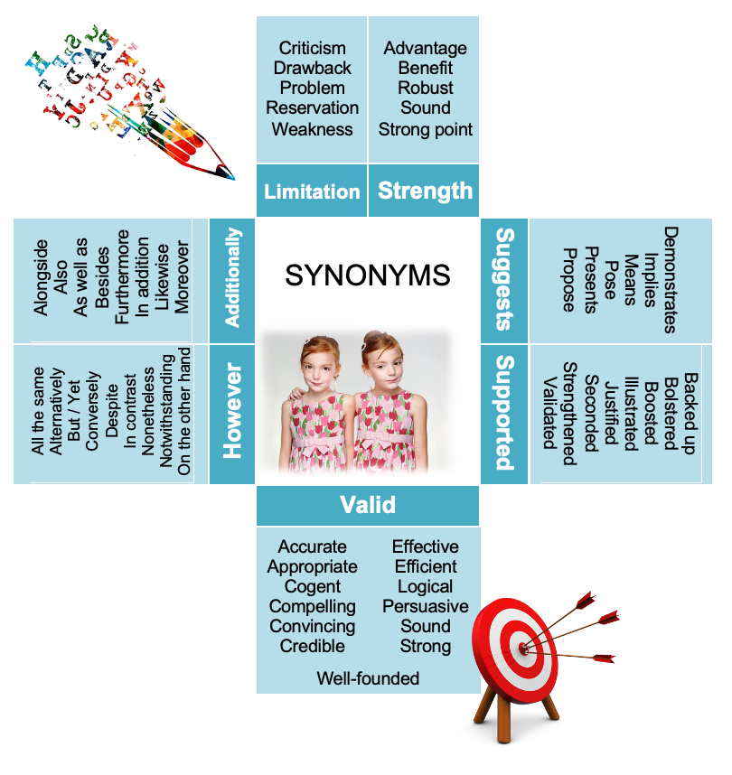
Synonyms for common words used in psychology essays …

Slide 27


Banned words and phrases …
Prove | Suggests/Demonstrates
Must/Will | May/Could
He/She/They | The researcher(s) …
I think that / In conclusion … | It could be suggested that (this should ALWAYS be based in evidence – your opinions are not relevant to the Assessment Objectives)
Insignificant | Non/non-significant
Came up with | Proposed/suggested that
Good/Bad thing | A strength/limitation
Got participants | Used a sample of … / Recruited participants to …
Went … / Done/Did a study … | The researcher(s) investigated/studied/ carried out/conducted …

Slide 28
Command words …
Command Words | Description
Analyse | Separate information into components and identify their characteristics. Explain what something suggests about a behavioural phenomenon.
Assess | Weigh up the evidence, strengths and limitations to decide on the validity/value/effectiveness/appropriateness of a particular concept/study/theory.
Calculate | Work out the value of something. If more than 1 mark - show your working.
Comment | Present a reasoned, informed opinion based on the available evidence.
Compare | Identify similarities and/or differences.
Consider | Review and respond to given information.
Describe | Set out characteristics, possibly with the use of examples.
Discuss | E.g.: Discuss genetic explanations for aggression. This question is asking for knowledge (AO1) of the genetic explanations plus a discussion (AO3) of the evidence in support of the theory plus other relevant strengths and limitations. Discussion implies counterargument. Alternative question: Discuss the value of research into the working memory model - asked to consider the various strengths and limitations of the research into this model and the implications this has for its value to society.
Distinguish | Explain ways in which two concepts/studies/theories/behaviours differ. Will usually need to refer to both/all concepts identified in the question.
Evaluate | Judge from available evidence. Consider the available research evidence plus relevant strengths and limitations and what this suggests about the specific explanation/study, as well as the application to and implications for the real world.
Explain | Set out purposes or reasons, similar to ‘describe’. In more detail than ‘outline’. Usually referring to knowledge (AO1). However, ‘explain one limitation’ would require you to identify a limitation then explain how it is a limitation (AO3).
Identify | Name or otherwise characterise. No need for description.
Justify | Provide reasons, reasoned argument to support your decision/point being made, possibly provide evidence.
Name | Identify using a recognised technical term.
Outline | Set out main characteristics. Usually in less detail than the available information. Make sure you still answer the question to the best of your ability, even if less marks are available. Giving an example will help to show your understanding.
State | Express in clear terms. This will be a brief response.
Suggest | Present a possible case/solution, based on available evidence (which may be given in the question) and/or knowledge from the A-Level topics.
What is meant by | Give a definition (and possibly an example)
Write | Provide information in verbatim (as if said out loud) form.
… are those words and phrases used in exams and other assessment tasks that tell students how they should answer the question. The following command words are taken from Ofqual’s official list of command words and their meanings that are relevant to this subject. In addition, where necessary, AQA have included specific command words and their meanings relevant to the subject.

Slide 29
Psychology Careers
The BPS website has lots of information about careers in Psychology which you can find here: https://www.bps.org.uk/find-your-career-psychology
How to get started in psychology: https://www.bps.org.uk/getting-started
The next page speaks about Psychology at university. If you have any questions, speak to Miss Miller, Miss Evans or Mr Martin.

Slide 30
Psychology at University
Psychology A Level is not a mandatory requirement, but it is useful.
Most degree level courses require a science A Level, and Psychology counts as this in most cases.
If studying Psychology at university it is vital that you study a BPS accredited course. Universities put this on the subject pages, but you can also find a list of accredited courses here.

